Slide 1



ArcGIS API for Python: Administering ArcGIS Online
Noah Paravicini, John Yaist
ESRI USER CONFERENCE 2024
Copyright © 2024 Esri.
All rights reserved.
Notes:
Esri Corporate Template-Dark v4.5
December 7, 2023 Copyright © 2024
Purpose of this slide:
While the audience waits for your presentation to begin, use this slide as a visual introduction.
How to customize this slide:
Add your approved session title, located in the detailed agenda on the UC site.
If the session title does not match what you think it should be, please reach out to your topic lead.
Add the names of each presenter according to the following example: Name 1, Name 2 & Name 3
(Optional) Speaker notes:
This is an optional space for you to add more detailed speaker notes. These notes should elaborate on the concise main points and visuals in the slide.

Slide 2



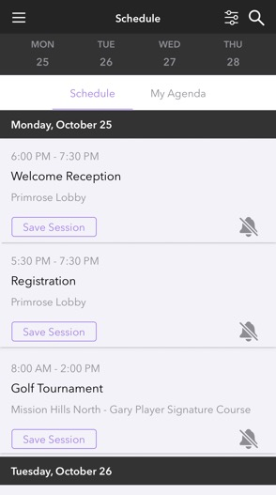

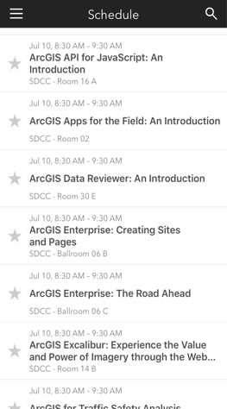
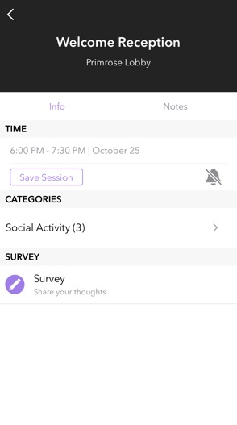
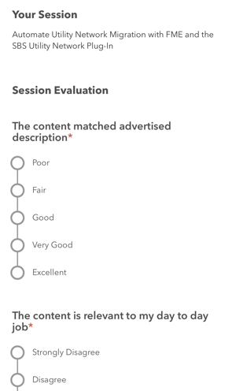




Please share your feedback in the app
Download the Esri Events app and find your event
Select the session that you attended
Scroll down to “Survey”
Log in to access the survey
Notes:
Purpose of this slide:
Encourage the audience to share feedback by completing the survey, available in the event app on the page for this presentation.
How to customize this slide:
No customization is required.
(Optional) Speaker notes:
This is an optional space for you to add more detailed speaker notes. These notes should elaborate on the concise main points and visuals in the slide.

Slide 3

Notebooks will be available after session
https://github.com/Esri/arcgis-python-api

Slide 4
Agenda
What is the Python API?
Documentation Resources
Demos
Questions
Notes:
Purpose of this slide:
Let the audience know what to expect during your presentation.
Your agenda can provide the structure that outlines your presentation into sections.
How to customize this slide:
List 3–5 major sections that you will discuss and potentially demonstrate during your presentation. (For example, for a presentation on ArcGIS Pro, you may have a Template section where you cover several topics and demo one topic, like Configuring a Feature Template.)
(Optional) Speaker notes:
This is an optional space for you to add more detailed speaker notes. These notes should elaborate on the concise main points and visuals in the slide.

Slide 5
What is the API for Python?
Major task areas
Python library allowing you to
Visualize and analyze data – specializing in web services
Manage assets - users, groups, items, services
Administer your Web GIS organization
Notes:
Purpose of this slide:
Provide a high-level overview of the featured product, capability, or technology.
How to customize this slide:
Add the product name, capability, or technology to the title.
Add a short, bulleted list describing the product, capability or technology (no more than 5 bullets in a list; around 5 words per bullet).
(Optional) Speaker notes:
This is an optional space for you to add more detailed speaker notes. These notes should elaborate on the concise main points and visuals in the slide.

Slide 6

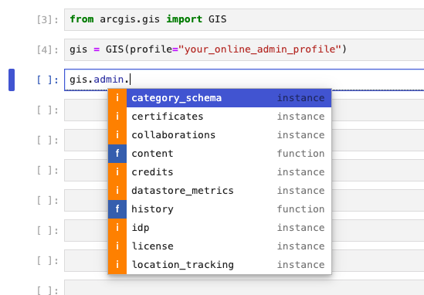
Accessing administrative functions
Log on with admin credentials
Type: gis.admin
Type another dot, hit tab:
Notes:
Purpose of this slide:
Organize your presentation based on the sections identified in your agenda.
When transitioning to a new section, use this slide as a visual indicator.
How to customize this slide:
Add a title that matches the section listed in your agenda.
If a different presenter will be speaking, list the name of the presenter.
Duplicate this slide as many times as necessary.
(Optional) Speaker notes:
This is an optional space for you to add more detailed speaker notes. These notes should elaborate on the concise main points and visuals in the slide.

Slide 7
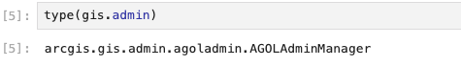
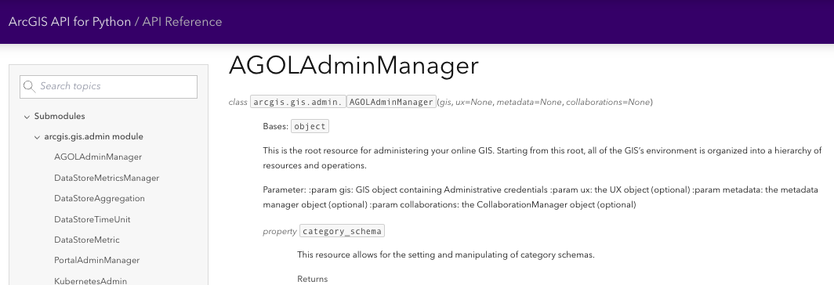
gis.admin – admin property only available to administrators
https://developers.arcgis.com/python/api-reference/arcgis.gis.admin.html#agoladminmanager
Notes:
Purpose of this slide:
Include graphic(s) that provide context to support the topic.
How to customize this slide:
Identify one main topic that supports the section.
Add a graphic that effectively supports the audience’s understanding of the topic:
Conceptual graphics are visuals that illustrate an abstract idea (for example, a visual of several icons representing the updated capabilities of a geoprocessing tool).
Process outputs are visuals that provide examples of results (for example, a map showing merged polygons as a result of using a new geoprocessing tool).
If adding more than one graphic, ensure that each graphic is visually highlighted in alignment with your talking points for the slide.
If additional context is needed, add text sparingly and near the supporting graphic.
Duplicate this slide as many times as necessary.
(Optional) Speaker notes:
This is an optional space for you to add more detailed speaker notes. These notes should elaborate on the concise main points and visuals in the slide.

Slide 8
Demos
Notes:
Purpose of this slide:
Organize your presentation based on the sections identified in your agenda.
When transitioning to a new section, use this slide as a visual indicator.
How to customize this slide:
Add a title that matches the section listed in your agenda.
If a different presenter will be speaking, list the name of the presenter.
Duplicate this slide as many times as necessary.
(Optional) Speaker notes:
This is an optional space for you to add more detailed speaker notes. These notes should elaborate on the concise main points and visuals in the slide.

Slide 9
Please share your feedback in the app
Download the Esri Events app and find your event
Select the session that you attended
Scroll down to “Survey”
Log in to access the survey
Notes:
Purpose of this slide:
Encourage the audience to share feedback by completing the survey, available in the event app on the page for this presentation.
How to customize this slide:
No customization is required.
(Optional) Speaker notes:
This is an optional space for you to add more detailed speaker notes. These notes should elaborate on the concise main points and visuals in the slide.

Slide 10
Questions
Notes:
Purpose of this slide:
While the audience asks questions about your presentation, use this slide as a visual.
How to customize this slide:
No customization is required.

Slide 11


Copyright © 2024 Esri. All rights reserved.
Notes:
Copyright © 2024

